Slide 1


INSTAHYRE
JOB
ANALYSIS

Slide 2
INTRODUCTION
INTRODUCTION
Welcome to the Instahyre Job Analytics Project, a data-driven endeavor that scrapes job posting data from Instahyre, preprocesses it, and employs clustering analysis to unearth valuable insights. The project's central goal is to provide job seekers and recruiters with essential data for decision-making. Concluding with the development of an interactive web application, it empowers users to explore job market trends and insights, benefiting both job seekers and recruiters in making informed choices in the ever-evolving job market landscape
Welcome to the Instahyre Job Analytics Project, a data-driven endeavor that scrapes job posting data from Instahyre, preprocesses it, and employs clustering analysis to unearth valuable insights. The project's central goal is to provide job seekers and recruiters with essential data for decision-making. Concluding with the development of an interactive web application, it empowers users to explore job market trends and insights, benefiting both job seekers and recruiters in making informed choices in the ever-evolving job market landscape

Slide 3


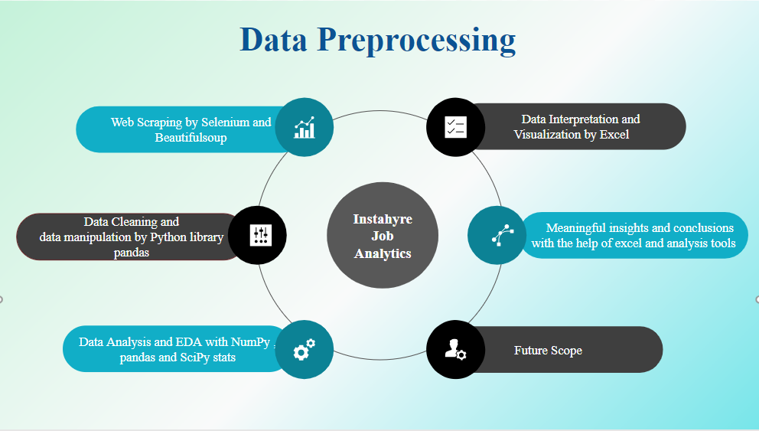
Data Interpretation and Visualization by Excel

Slide 4

Challenges
1. Webpage Design: Designing a webpage with HTML and CSS presented challenges in making it both visually appealing and functional.
2. User Input Handling:Managing user input for text processing and learning was complex, requiring effective validation and processing mechanisms.
3. Backend Development: Developing the backend with Flask was a bit challenging, particularly when setting up data communication between the frontend and backend components.
6. Web Scraping : Web scraping using the Selenium library
presented its own set of challenges, from handling dynamic
web pages to efficient data extraction.

Slide 5

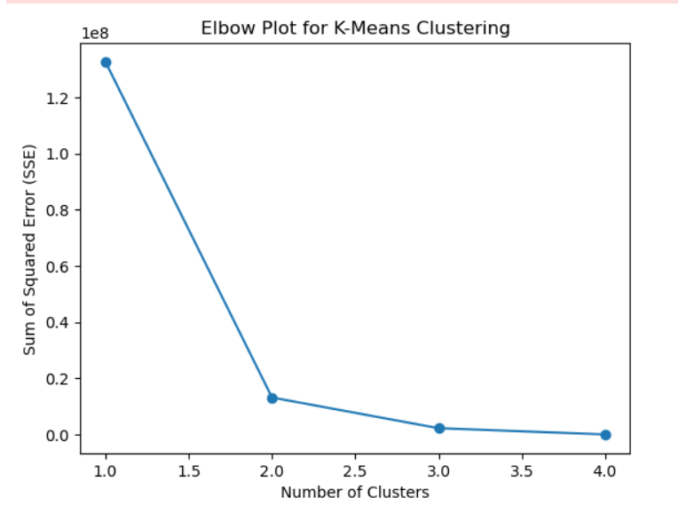
MODEL BUILDING
Elbow clustering, often used in K-Means, is a technique to determine the optimal number of clusters (k) for a dataset.
It involves running K-Means for a range of k values and then looking for the "elbow point" on a plot of the cost or variance against k.
Elbow point indicates the point where increasing the number of clusters no longer significantly reduces the within-cluster variance.
Silhouette Score of 0.97998 indicates a strong level of separation and appropriateness of the clusters in your K-Means model, which is a positive outcome for your data analysis.

Slide 6

WEBPAGE CREATION
In the development of our project, creating the interactive webpage was a pivotal step.
We utilized HTML and CSS, combining design aesthetics with functional elements to ensure a seamless user experience.
This webpage acts as the gateway for users to explore the insights and trends derived from our data analysis, offering a visually appealing and user-friendly platform for data exploration.

Slide 7
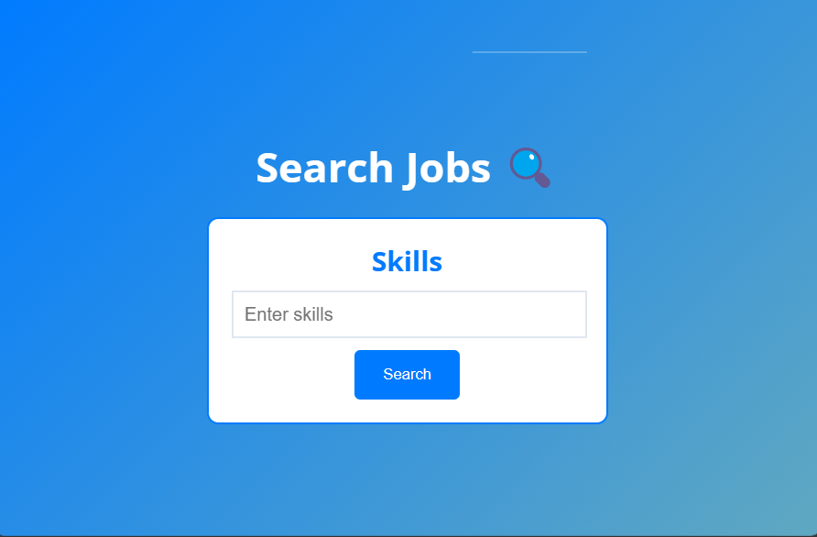
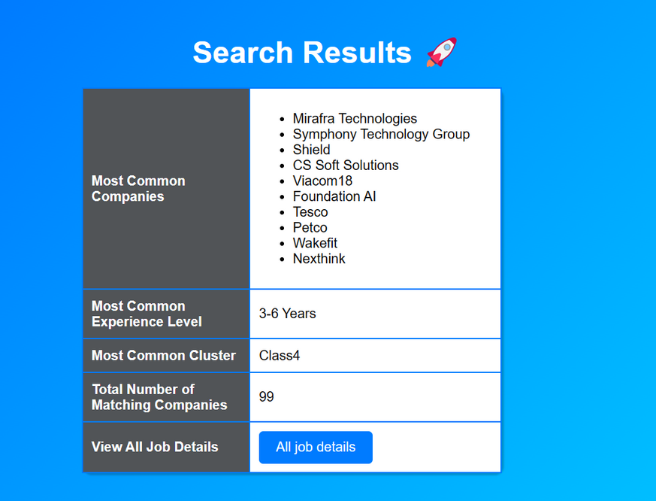
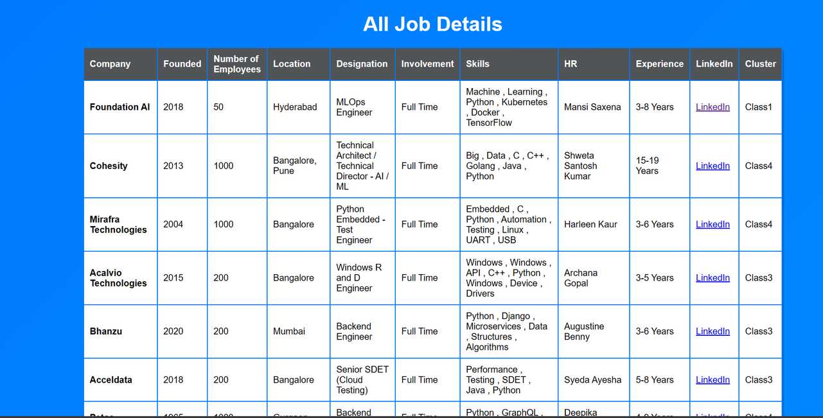

Slide 8


The Instahyre Job Analytics Project has successfully harnessed data to provide valuable insights into the job market. By collecting, processing, and analyzing data, we've empowered job seekers and recruiters with the tools needed to make informed decisions. The development of our interactive web application offers a user-friendly experience, ensuring the accessibility of these insights. This project serves as a testament to the power of data-driven decision-making and the impact it can have on the job market landscape.

